Slide 1
WELCOME
TO THE NU COMPUTING SOCIETY

Slide 2


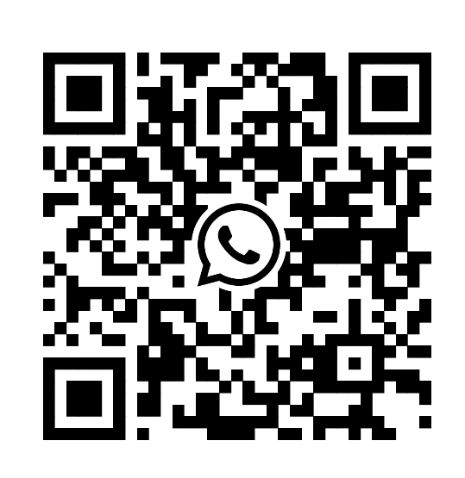
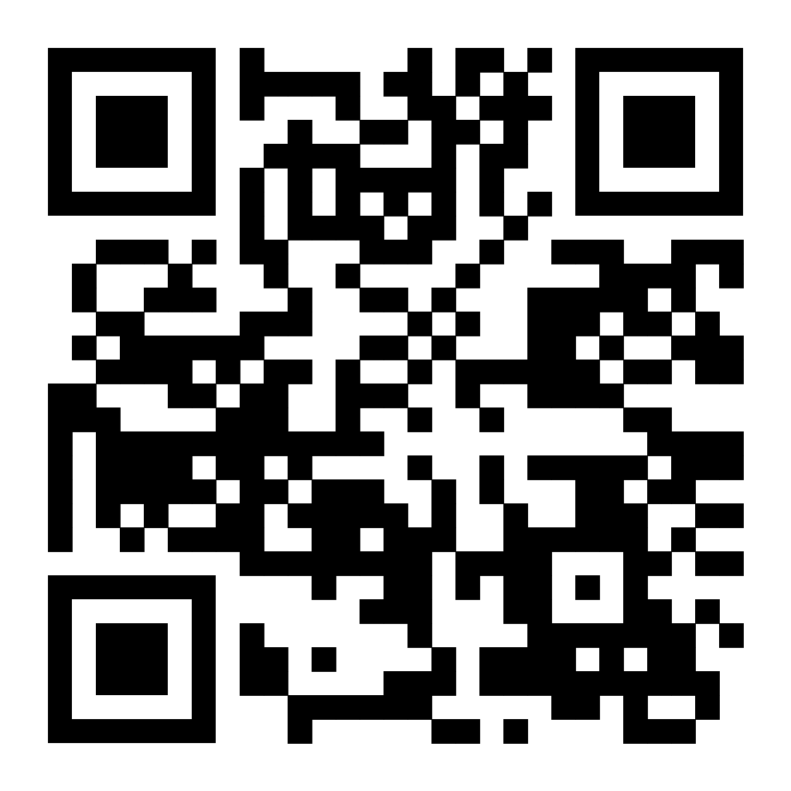
Discord + Whatsapp Groups

Slide 3
Github
NU Computing Society

Slide 4

Why use Github?
Why You Should Use GitHub for Your Projects
Industry Standard
GitHub is the platform that top tech companies and developers use to collaborate, share, and manage code. It's a must-know tool for anyone looking to enter the tech industry.
Familiarity with GitHub gives you an edge when applying for jobs, internships, or contributing to open-source projects.
Fast and Secure Code Backup
GitHub makes it easy to back up your code and ensure it's safe, even if your local device fails.
You can access your repositories from anywhere, ensuring you never lose your work again.
Code Auditing and Transparency
GitHub offers tools that allow you to audit your code and track every change made to a repository. You can view commit histories, compare versions, and even undo mistakes easily.
Transparency is key when working on collaborative projects, and GitHub provides detailed insights into contributions made by different team members.

Slide 5
Why use Github?
Easy Sharing and Collaboration
With GitHub, sharing your code is as easy as clicking a link. Whether you’re collaborating with teammates or showcasing your projects to potential employers, it’s all at your fingertips.
It’s simple to download or clone repositories, allowing others to quickly get up to speed and contribute.
Fork and Contribute
GitHub allows users to fork repositories, meaning others can create their own copy of your project to make edits without changing the original code.
This encourages collaboration and idea-sharing without the risk of messing up your repository.
Showcase Your Skills
Use GitHub as a portfolio to display your personal and group projects. Employers and fellow developers will be able to see the quality of your work and your ability to collaborate.
Build a public profile that showcases your contributions to open-source projects, making your GitHub repository a testament to your skills and experience.

Slide 6
Getting Started
Make an Account
Go to GitHub's website and click on Sign up -> https://githhub.com
Follow the prompts to create your account. You’ll need a username, email, and password. After that, you’ll receive a confirmation email to verify your account.
Create Your First Repository
Once logged in, click on the + sign at the top right corner and select New repository.
Choose a name for your repository, and optionally, add a description. You can select whether your repository is public or private (public is great for sharing with the community).
Initialize the repository with a README file to describe your project and hit Create repository.

Slide 7
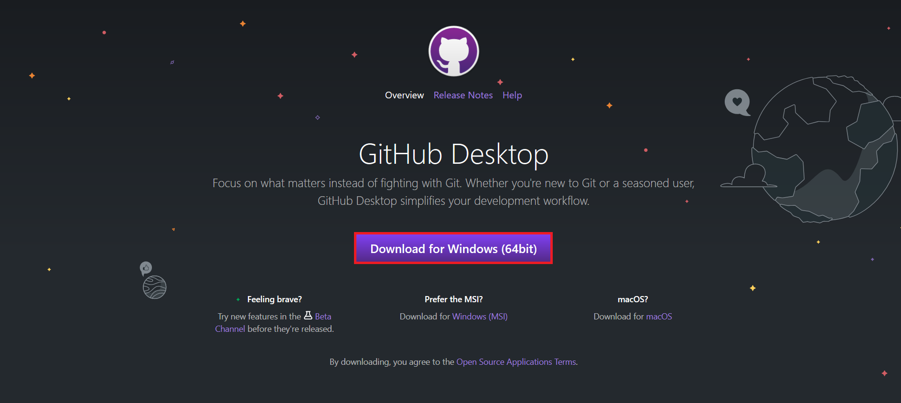
Getting Started
Connect to GitHub Desktop
Download GitHub Desktop if you don’t have it installed -> https://desktop.github.com/
Open GitHub Desktop and sign in with your GitHub account.
Once connected, you can clone the repository you just created, or create a new local repository and push it to GitHub.

Slide 8
Getting Started
Create Something
Start coding! Open the repository in GitHub Desktop, and create your project files using your favorite text editor or IDE.
As you work, make sure to regularly save your progress in the local repository.
Need an idea?
Perhaps start with just a ‘Hello World’ Project? Or a Simple question based system?

Slide 9
Getting Started
Upload (Push) Your Code to GitHub
In GitHub Desktop, after making changes to your code, you’ll see the changes listed under Changes.
Add a commit message to describe the changes you’ve made (e.g., “Initial project setup”).
Click on Commit to main (or your current branch).
Finally, click on Push origin to upload your code to your GitHub repository online.

Slide 10
Homework (If you want to)
Showcase something you are skilled about in Python:
This can be a website, app, game. Whatever!
Examples:
Flask Website
Small PyGame
Calculator or a Word Processor (Like a notepad)

Slide 11
What have I learned?
Basic GitHub Usage: You now understand how to create a GitHub account, set up repositories, and manage your projects on the platform.
Creating and Managing Repositories: You know how to create, initialize, and manage repositories on GitHub, which are essential for organizing and showcasing your projects.
Backing Up Code: You've learned how to backup your code securely to GitHub, ensuring your work is safe and accessible from anywhere.
Using GitHub Desktop: You can now connect to GitHub Desktop to manage your local repositories and synchronize changes with your GitHub account.
Collaborative Work: You've mastered the basics of collaborating with others via GitHub by forking repositories, pushing changes, and using commit messages to track progress.

Slide 12
What have I learned?
Project Showcasing: You’re able to use GitHub as a platform to showcase your personal projects, which can enhance your professional portfolio.
Version Control: You understand the importance of version control, using GitHub to track code changes, collaborate with others, and manage different versions of your project.
Improving Your GitHub Profile: You now have the foundation to improve and personalize your GitHub profile, which can be a great asset in job searches or project collaborations.

Slide 13
Okay… Why?
You now have some skills to Add to Your CV!
GitHub: Proficient in using GitHub for code management, collaboration, and version control.
GitHub Repositories: Experienced in creating, managing, and organizing repositories for personal and collaborative projects.
Backing Up Code: Skilled in backing up code and maintaining secure, accessible project files via GitHub.
Collaborative Work via GitHub: Able to work efficiently in teams by using GitHub for collaboration, forking, and merging code.
Issue Tracking: You’ve learned how to create and manage issues in GitHub to track bugs, feature requests, and tasks. This makes it easier to organize and manage your project.
Project Documentation: By creating README files and adding comments to your code, you’re able to effectively document your projects, making it easier for others to understand your work and contributing to the open-source community.
Open-Source Contribution: You've gained insight into the open-source culture, learning how to contribute to public repositories and how your work can be shared and built upon by others in the community.

Slide 14
Using Itch.io
NU Computing Society

Slide 15
What is Itch.io?
Itch is a free game platform like Steam however it is free to upload onto and they do not take a cut, meaning if you want, you can take 100% of your earnings.
You can customise your profile and make a profile for each game you make. You can have 100% customisation of the page and they are quite open to whatever games you want to upload. You can allow people to comment or even have a forum around your game.

Slide 16
Why use Itch.io
YouTubers often use Itch.io which means you will get a good amount of viewership on your game. Since the games here are indie and are usually free, the bar for entry is low and people will not be too critical of your game. It is a great place to trial an idea or get early feedback of a game.
You will also find many people will upload reviews or them playing the game in the comments so it’s easy to find where your viewership is coming from.
Itch also allows for the creation and participation of Game Jams which we will be doing from week 6 - week 12. Here you can make a game within the timeframe, upload it and allow others to vote. You can earn prizes and more from such events.

Slide 17
What else do they offer?
Itch can also be used to find game development resources. You can find 2D and 3D assets, UI Icons and Audio. You can also find game development kits here to make your game design experience easier. A lot of the things you will find on Itch even for game development are going to be FREE or at the very least, quite cheap.
Here are some examples:

Slide 18
But I can’t make games!
Yes you can, even if you have never programmed before there are many ways to ‘make’ a game. Maybe you are better off as part of a team.
Audio / Dialogue
Art and Storyboarding
Programming
Level Design
3D Modelling

Slide 19
How to get started?
While this is focusing on Itch and not game development as a whole, we cant offer tons of information here but I would recommend the following:
Game Engines:
Unity
Unreal Engine
Godot
Where to find resources:
Itch.io
Freesound
Brackeys, Game developer toolkit
https://develop.games/ (Ran by PirateSoftware, he might be bad at WoW and not own up to it, but he can make good games)

Slide 20
Northumbria University
Game Jam
NU Computing Society

Slide 21
How to get started?
Please sign up using this link: https://itch.io/jam/nu-computing-society-game-jam-year-1
Game Engines:
Unity
Unreal Engine
Godot
Where to find resources:
Itch.io
Freesound
Brackeys, Game developer toolkit
https://develop.games/ (Ran by PirateSoftware, he might be bad at WoW and not own up to it, but he can make good games)

Slide 22

Game Jam Theme
The game Jam theme is ‘NEWCASTLE’. This is quite a simple and open theme to get us all started, it is entirely up to you how you interpret it! Just remember to have fun :)

Slide 23
COOL FUNNY STUFF
NU Computing Society

Slide 24

Local Opportunities
Exclusive Opportunity for Computing Society Members!
"Skill Up North East" Campaign In collaboration with Lumi & Cyber North
What’s On Offer:
Free Access: 50 free spots for motivated students to join this high-value program (normally £175 per participant).
Skills Development: Equip yourself with vital digital and AI skills that will boost your employability.
Career Opportunities: Gain practical experience through workshops and quests, with chances to win awards and access job placements or internships in the tech industry.

Slide 25
Local Opportunities
Why You Should Apply:
Hands-On Learning: Interactive workshops and quests led by industry experts.
Exclusive: Limited spots available – don't miss out on this career-boosting chance!
Direct Path to Jobs: Potential job offers and internships after completing the program.
How to Apply:
Visit: www.lumi.network/campaign for more details and to apply.
Deadline: Apply quickly – spots are limited!
BE SURE TO MENTION THE NU COMPUTING SOCIETY!

Slide 26
Code Katas
NU Computing Society

Slide 27
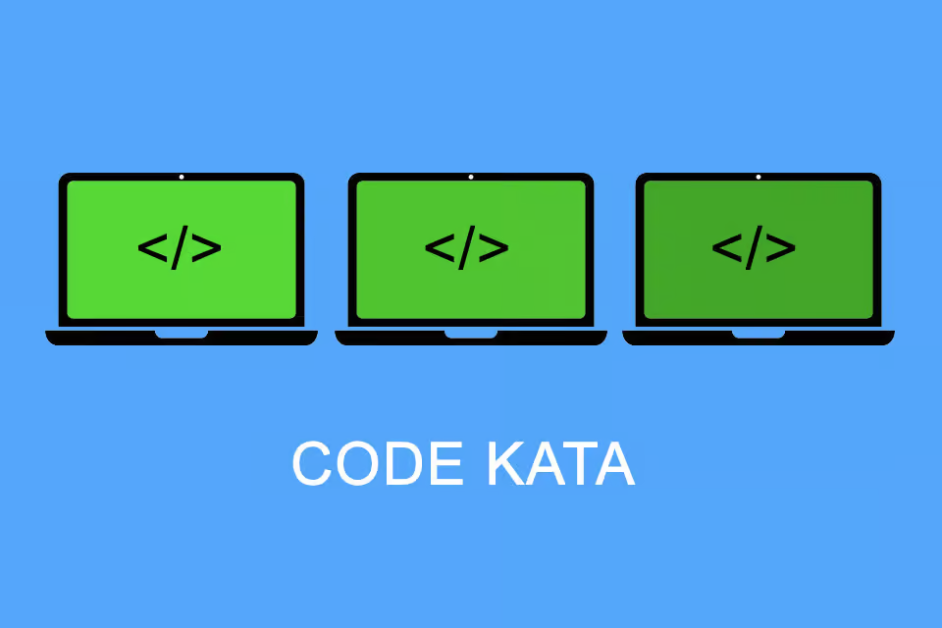
First off…
We can start by talking about where to work with us on CodeKatas, if you find that you enjoy doing them by the end of this lecture then you can join the NU Comp Society and help us score points for society prizes (and clout on the leaderboard…)

Slide 28
Where to go?
Codewars (Join our Clan “NU Computing Society”):
https://www.codewars.com/dashboard
Fun advent calendar for coding challenges:
https://adventofcode.com/
Very old school version of code katas:
http://codekata.com/

Slide 29
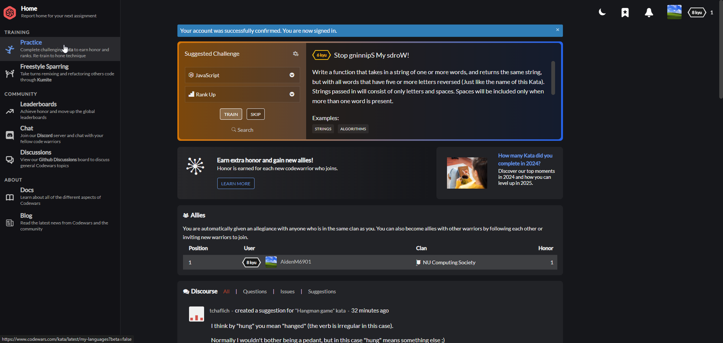
Codewars (Cool teamwork)

Slide 30
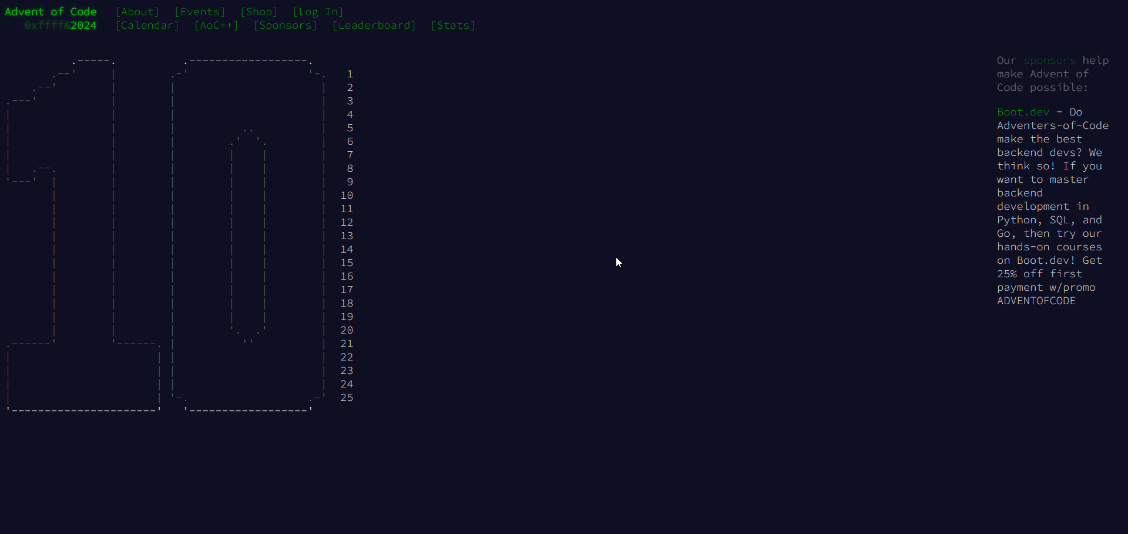
Advent of Code (Fun advent calendar)

Slide 31
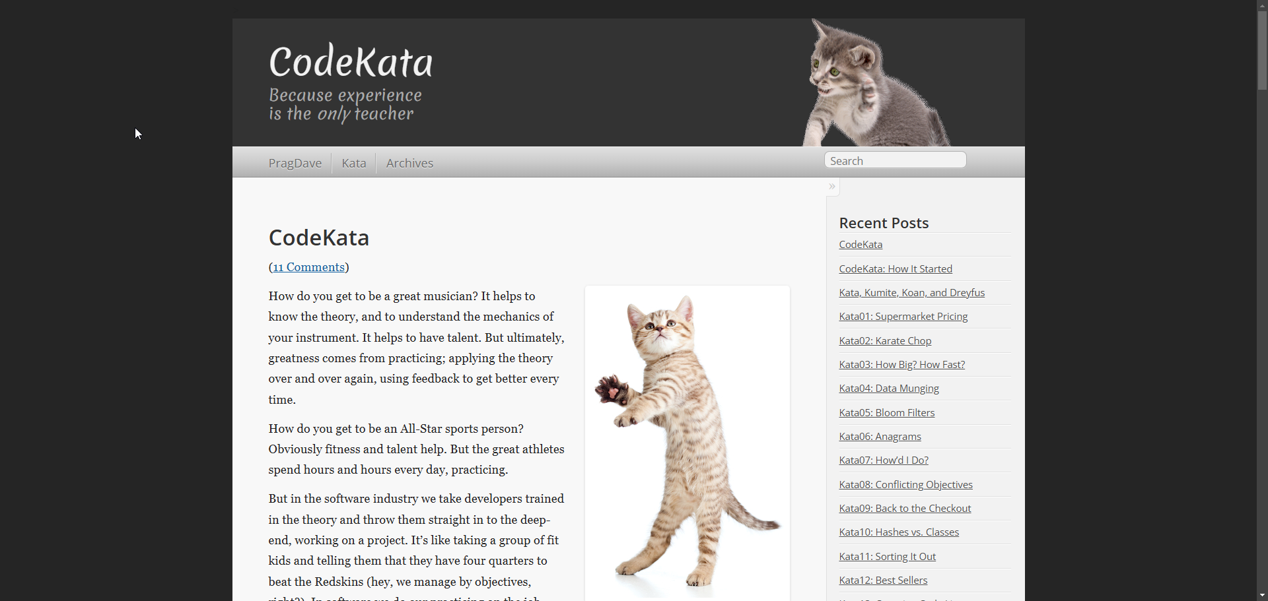
CodeKata (cats)

Slide 32
And now… A better version of what I have just said!
Special thanks to Kyle for helping us out and getting involved :)

Slide 33
Coding Kata
What is a Kata?
A kata is a pattern one practices to develop a skill or habit, which, in the workplace, results in streamlined processes and more effective performance.

Slide 34
Test Driven Development
The TDD way:
Write a test that fails
Write just enough code to make it pass
Refactor (if needed)
Start the next test

Slide 35
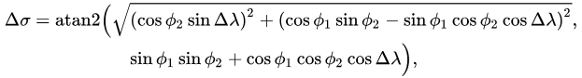
Great Circle Distance
https://en.wikipedia.org/wiki/Great-circle_distance
Read the JSON list of locations
Apply Great Circle Distance to get the spherical distance
Return a list sorted by distance from CIS
Include the distance in the list
Φ = latitude
Ƛ = longitude
Earth’s circumference? 40,075 km at equator 40,008 km at poles

Slide 36
What tests do you need?

Slide 37
DATASET
Very annoying and long link, The slides will also be available on the Discord Server and the link can be found there also!
https://drive.google.com/file/d/1QoVfA-tM2JLgeuaI9qrOQpCaQDi42N9b/view?usp=sharing

Slide 38
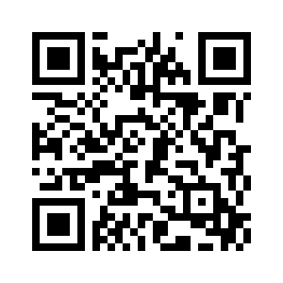
Feedback
Please send us some feedback using this form as it will help these sessions improve!

